Slide 1


React Front To Back
Welcome To The Course

Slide 2
Welcome To The Course
This course is the next step after learning JavaScript and wanting to move on to React
This is an intermediate course that is suitable for beginners as well as people that have worked with React before

Slide 3
What You Should Know
HTML & CSS (CSS not so important)
JavaScript Fundamentals
Basic programming principles
Bootstrap 4 not needed but will help

Slide 4
What You Will Learn
What is React?
Tooling & Setup
ES6+ Syntax
React Components
Understanding JSX
State
Props & PropTypes
CSS Styling & React
Conditional Rendering
Class & Style Binding
Working With Forms
Events
Context API
Lifecycle Methods
Working With HTTP
React Router v4
Lists & Keys
Fragments
Redux
Firebase/ Firestore (React-Redux-Firebase)

Slide 5
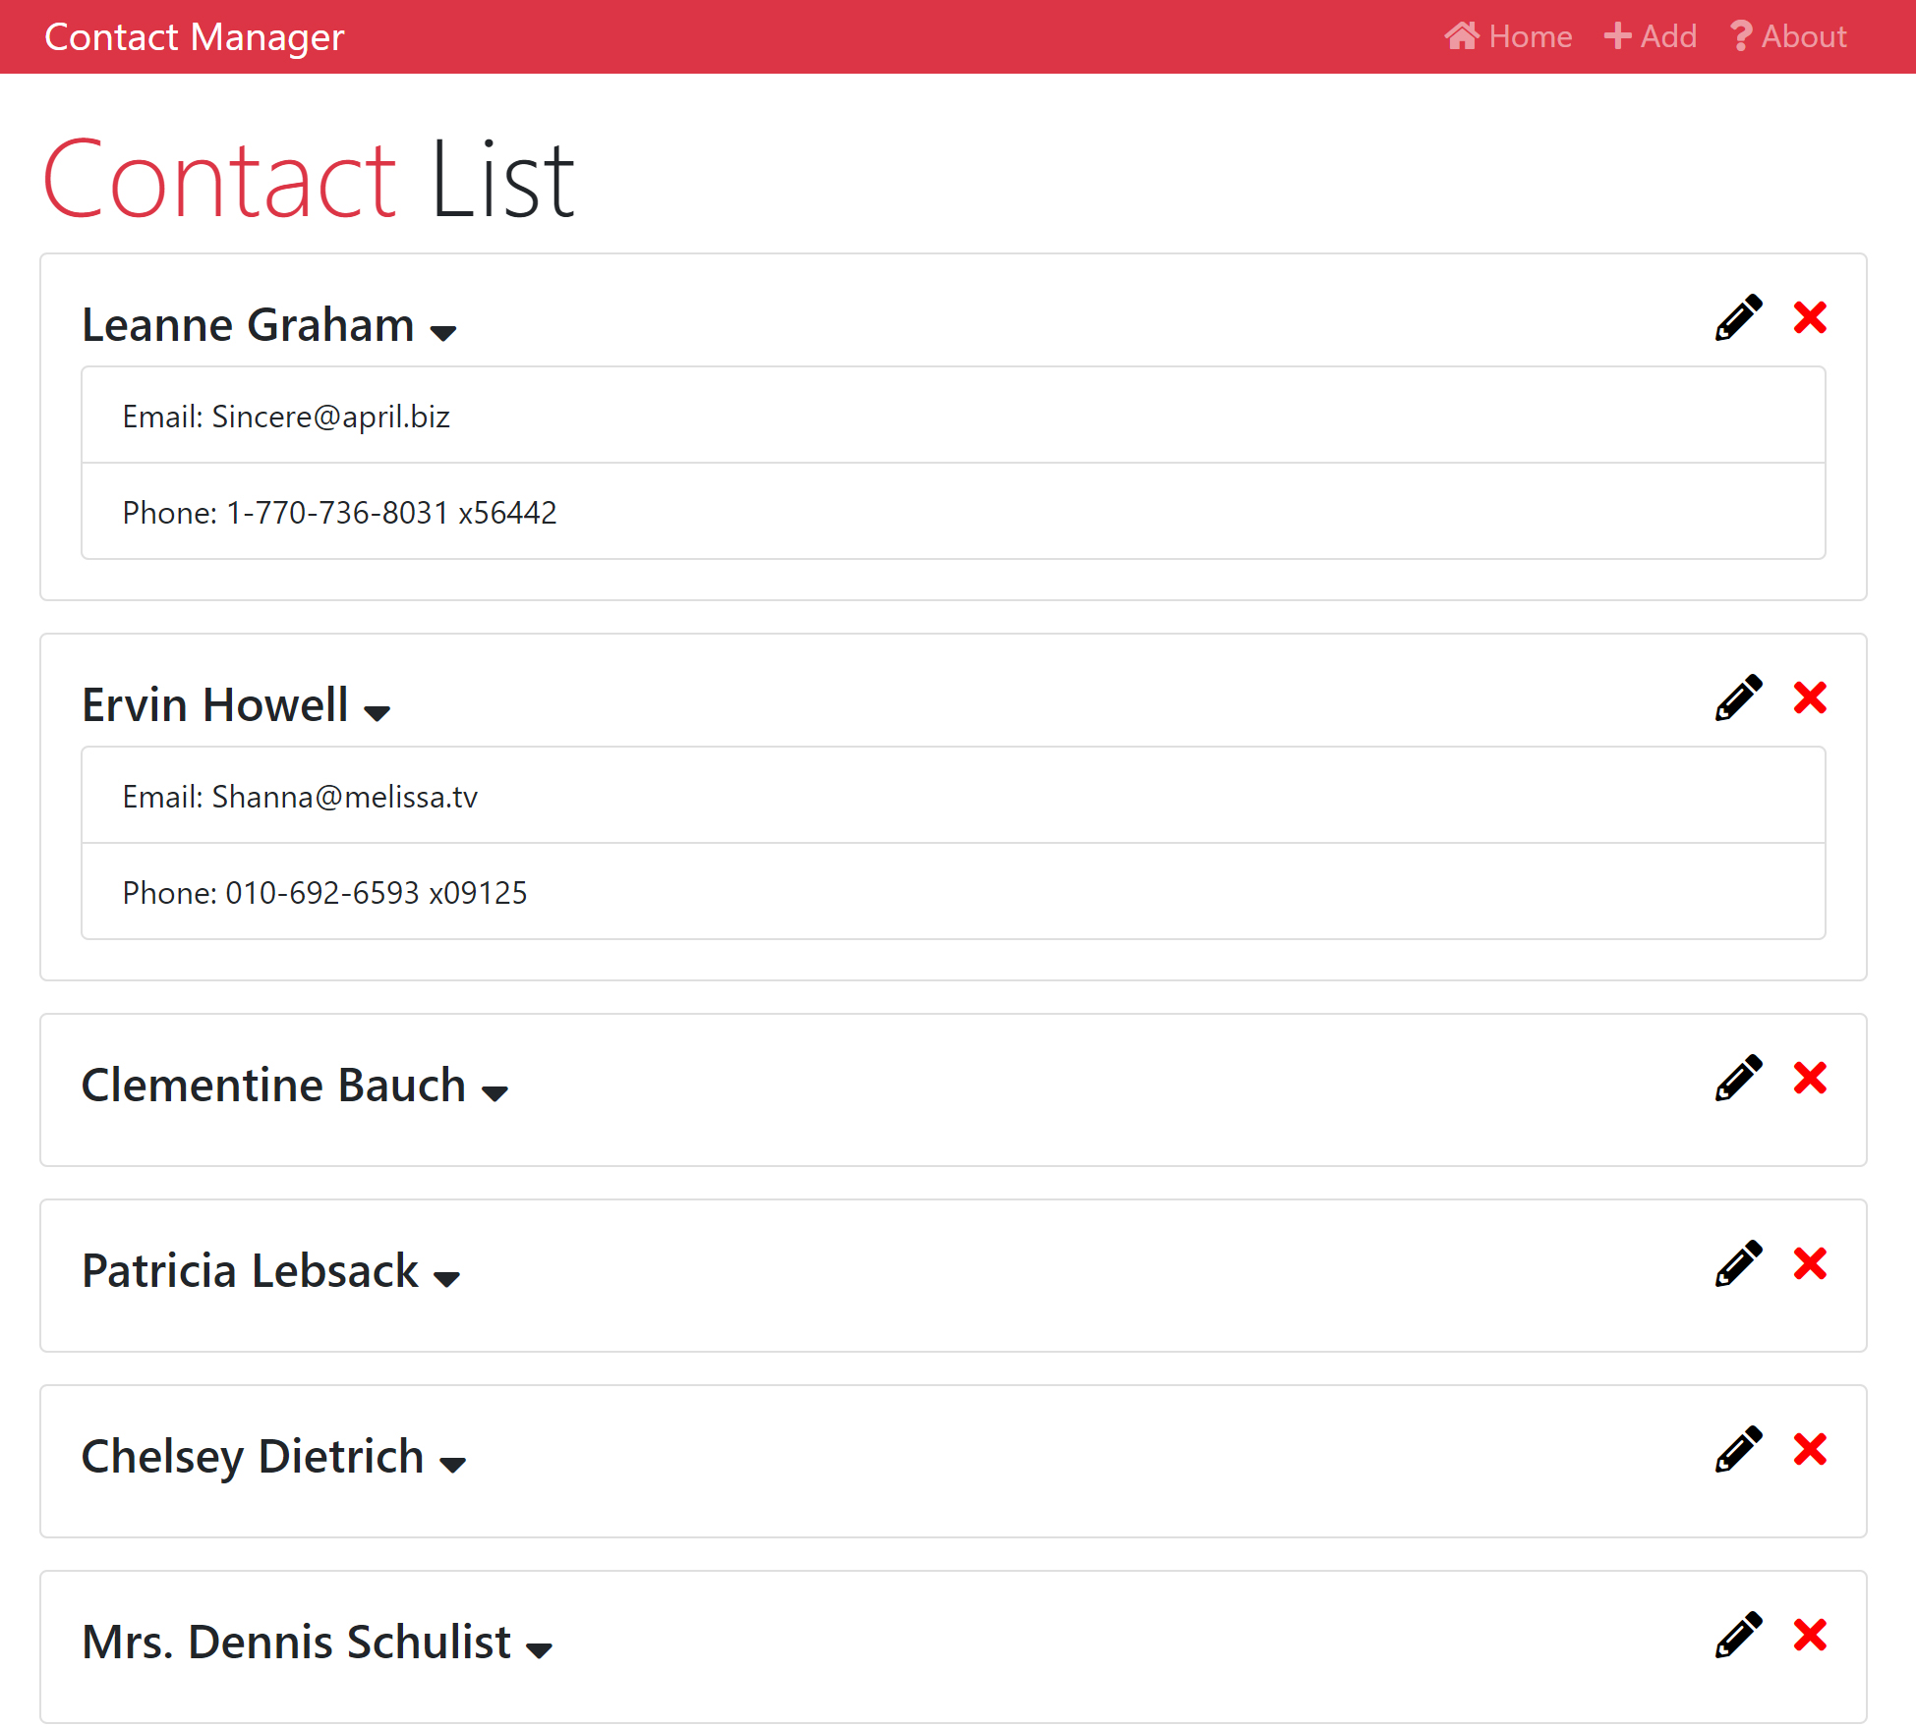
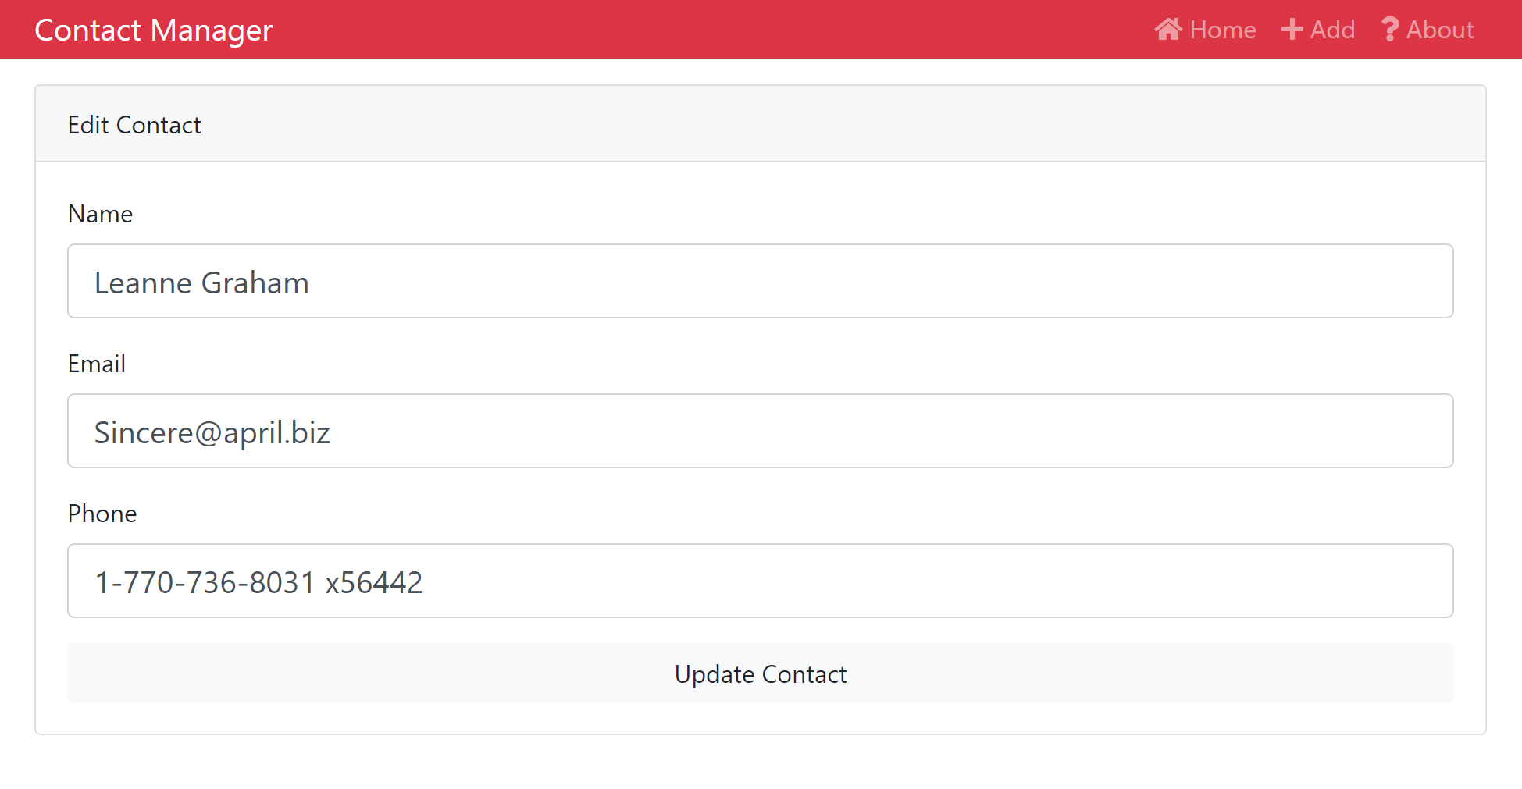
Learning Project

Slide 6
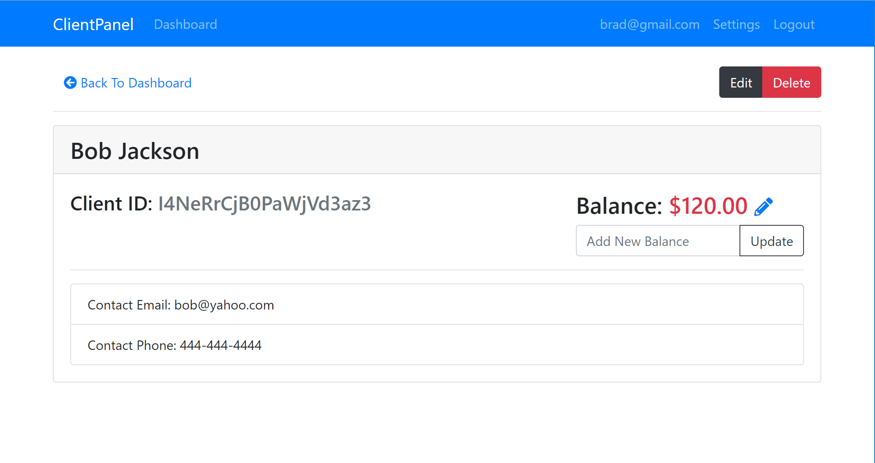
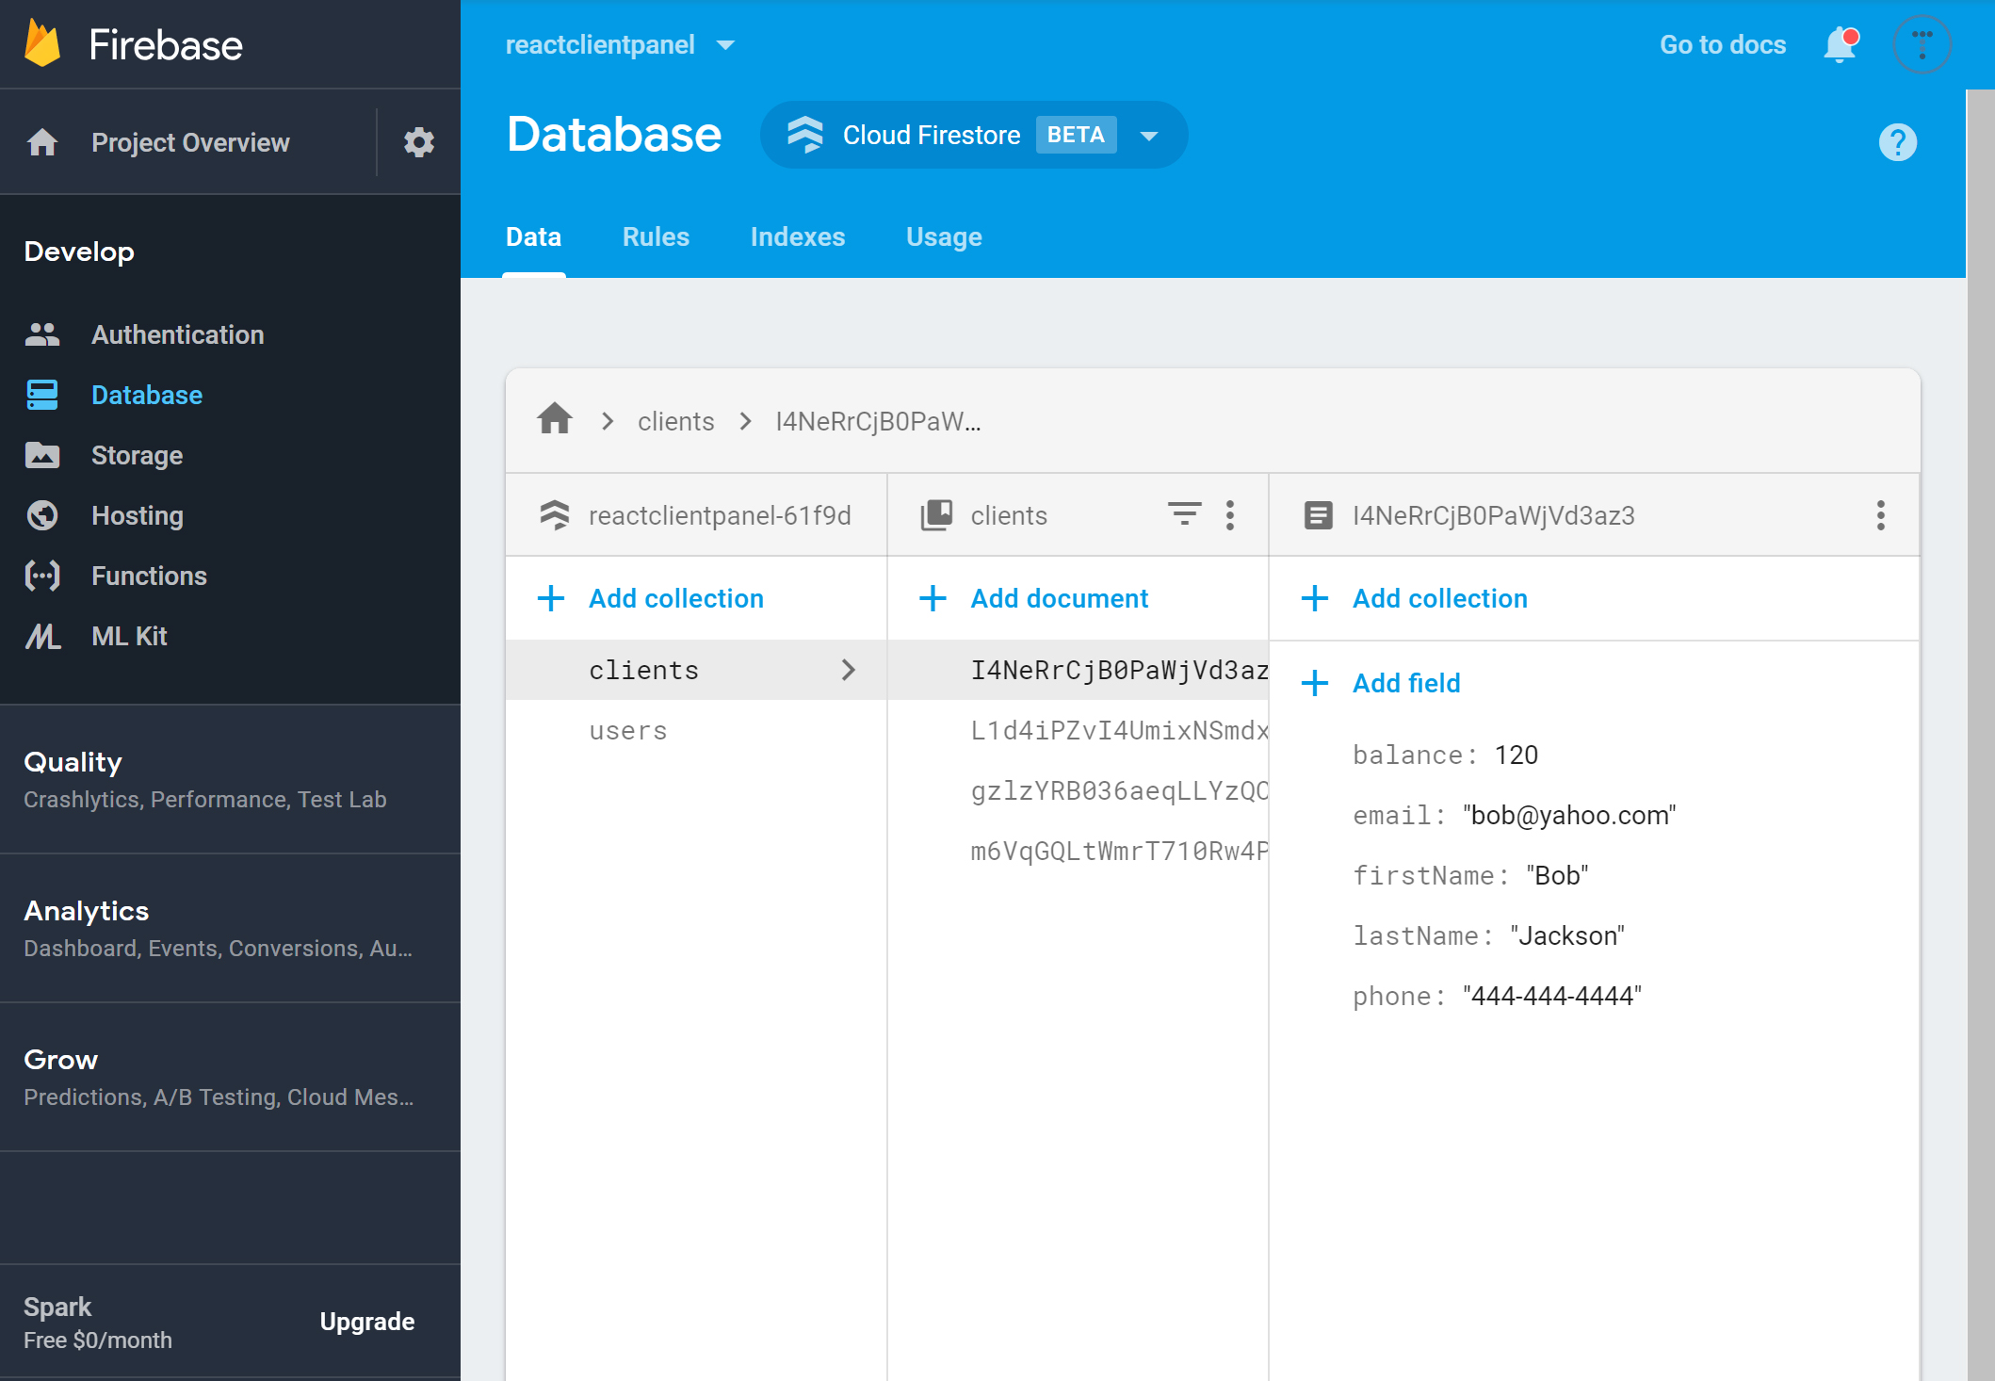
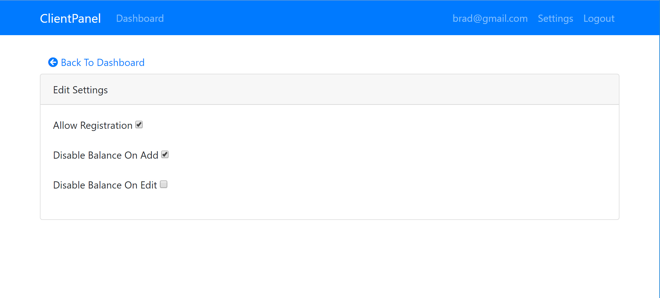
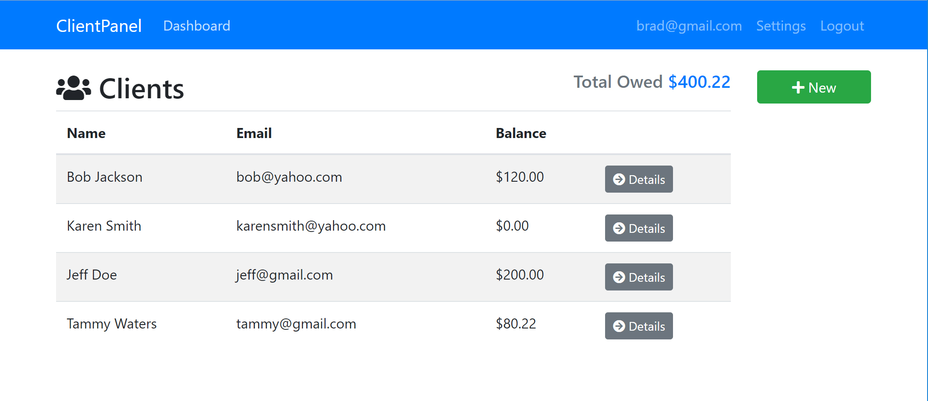
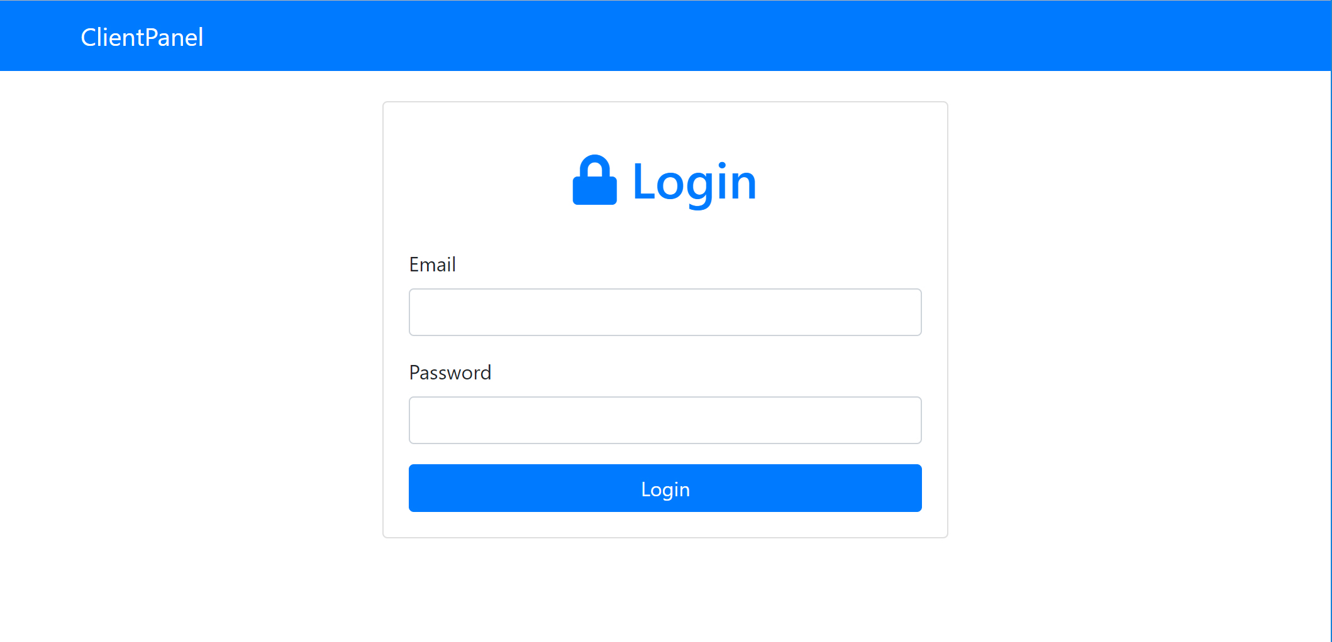
Final Project

Slide 7


FOLLOW BRAD:
Youtube.com/c/traversymedia
Facebook.com/traversymedia
Twitter.com/traversymedia
Linkedin.com/in/bradtraversy
Thank You
For Watching!
www.traversymedia.com

